Slide 1

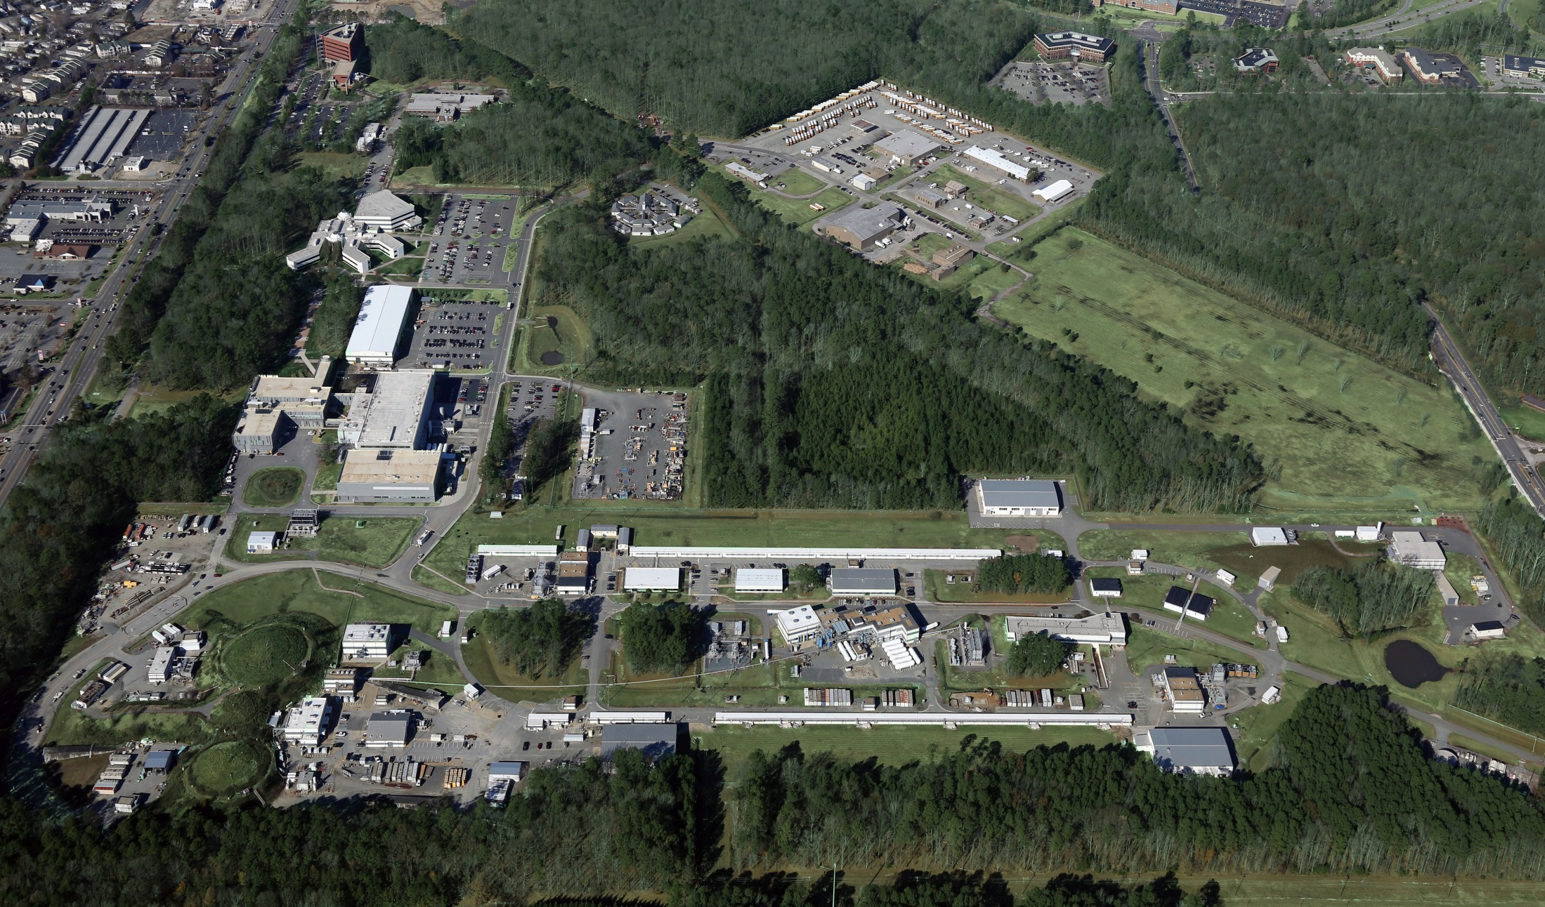
Jefferson Lab Overview
Stuart Henderson
Joint Hall A and C Collaboration Meeting June 22, 2017

Slide 2
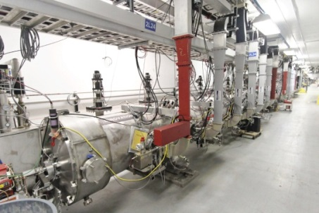
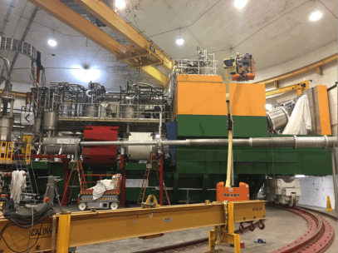
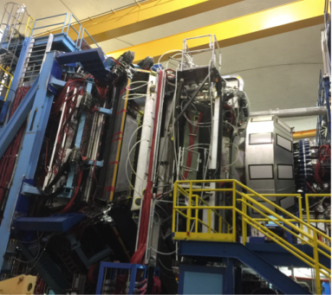
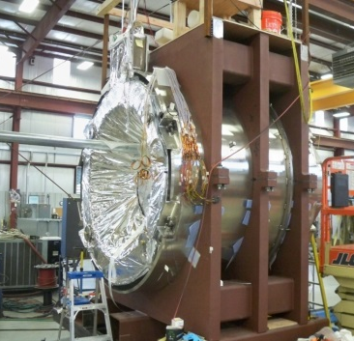
12 GeV Upgrade – Path to Completion
Project (99.7% complete):
Doubling the accelerator beam energy – DONE
Civil construction including utilities – DONE
New experimental Hall D and beam line – DONE
Upgrade to Experimental Hall C – DONE
Upgrade to Experimental Hall B – 99%
Accelerator
  Full 12 GeV energy achieved
  Full luminosity demonstrated
  Simultaneous multi-hall beam delivery achieved
Hall C – Key Performance Parameter demonstrated
  SHMS installed, commissioned with beam
  March 2017
Hall B – Key Performance Parameter demonstrated
  CLAS12 installed, commissioned with beam
  February 2017
Remaining Scope = Solenoid Magnet for Hall B
  Final phase of assembly at vendor, ETI
  June delivery to Jefferson Lab
  Installation and acceptance tests
Project Completion September 2017

Slide 3
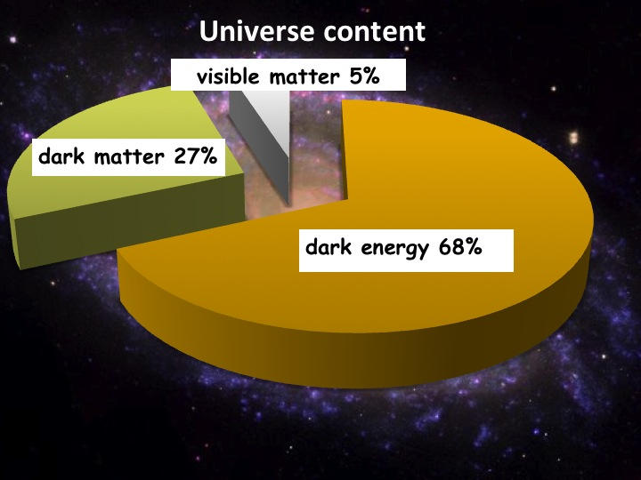
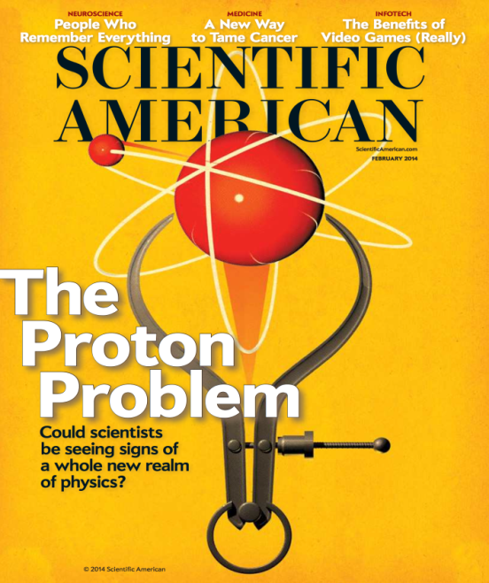
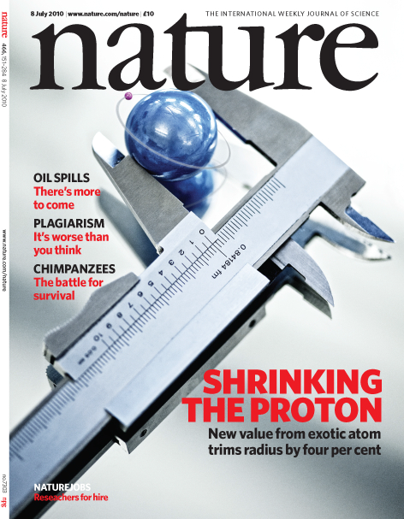
12 GeV Science Era has Begun!
Quark confinement: Hall D (GlueX) started physics operations
  Engineering Run Complete: Basis for > dozen papers at APS DNP Fall 2016 Meeting
  First 12 GeV era publication: 24 April, 2017!
  First physics run: 50 Billion events in Spring 2017
Nucleon Structure(I): Hall A in physics operations
  GMp experiment completed in Fall 2016
  First phase of DVCS experiment completed
Nuclear Structure: First experiment completed
  Argon Spectral Function experiment completed in Hall A in Spring 2017
Fundamental Symmetries: Hall B Heavy Photon Search
  First results of 2015 engineering run presented
Nucleon Structure (II): Hall B Proton Radius (PRad)
  Experiment run and completed Summer 2016
Starting to exploit the Upgrade for Physics

Slide 4
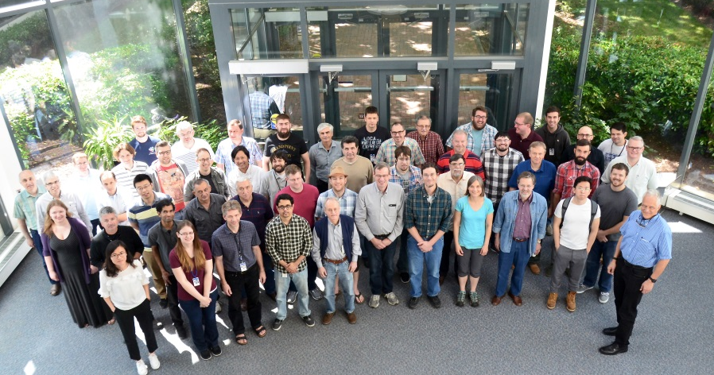
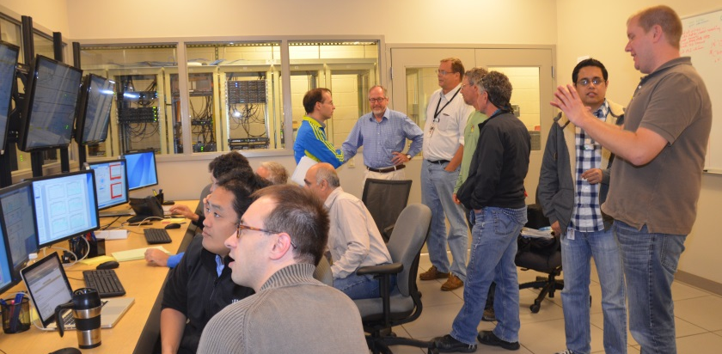
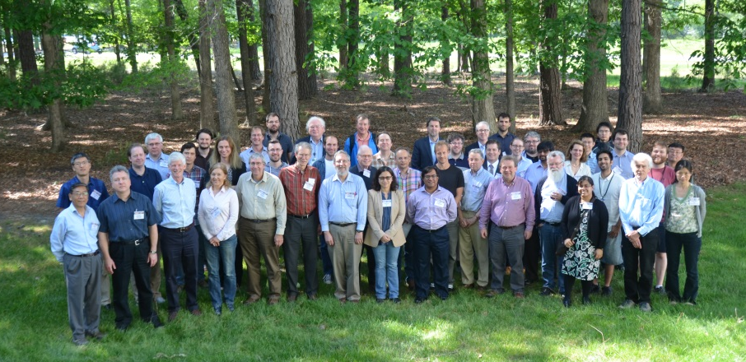
Enabling the Scientific Community to be Successful in Delivering Results
Deliver on the promise of the 12 GeV Upgrade
Successful, efficient and safe operation of the facility
      12 GeV must work as promised and deliver results
Ensure that experimental measurements translate into scientific knowledge
      Provide the community the tools needed to be successful
      Vibrant theory capabilities
      Computational sciences capabilities
Serve as an indispensable partner to the international scientific community
Get the most out of 12 GeV investment through future initiatives: MOLLER and SoLID
Delivering the 12 GeV Science Program is Job One

Slide 5
Planning for Sustainable Long-term CEBAF Operation
12 GeV Upgrade Project provides important capabilities for the future
However, many components and systems are “original equipment”
  Some are difficult to maintain, require adequate spare parts, will reach obsolescence
We have initiated an activity to develop a Reference CEBAF Operations Plan to:
  Define set of performance goals (e.g. reliability, energy, …), informed by scientific objectives, vs. time
  Analyze what it takes to ramp up performance and operate and maintain the facility to serve the needs of the community in both the near and long term.
  Assess, in particular, single-point failures, spares planning, …
  Scope includes accelerator, experimental and site operations

Slide 6
Operations Planning
Our working plan is a 10 week Fall run
Requires CHL cold-box recovery to be completed
In response to specific challenges with the CHL1 sub-atmospheric cold box, we have formed a Cold Compressor Advisory Committee to advise on the recovery path forward
  The FY17 appropriations includes funding for a new 2K cold-box to remedy this severe vulnerability in the long term
We have augmented the Accelerator Advisory Committee membership and will hold the next meeting Sept. 13-15, 2017

Slide 7
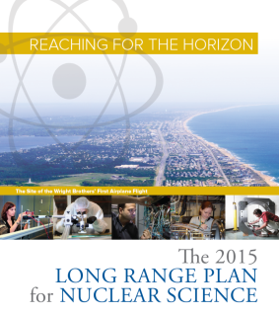
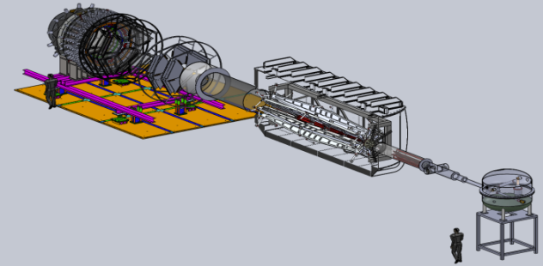
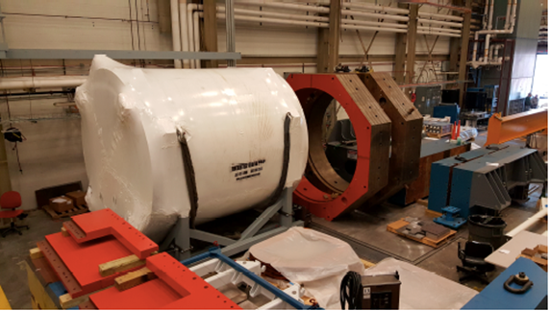
Future Projects to Fully Leverage 12 GeV Capabilities
RECOMMENDATION IV
We recommend increasing investment in small-scale and mid-scale projects and initiatives that enable forefront research at universities and laboratories.
MOLLER experiment – MIE, proposed FY19 start
– CD-0 approved
(project paused due to budget uncertainty)
– Standard Model Test
– DOE science review (Sept. 2014) – strong endorsement
– Director’s review held Dec. 15-16, 2016
Technical, cost & schedule
SoLID
– Semi Inclusive Deep Inelastic Scattering
(SIDIS) and Parity Violating Deep
Inelastic Scattering (PVDIS)
– CLEO Solenoid 
– International collaboration
– Director’s review (Feb. 2015)
 new pre-CDR under review
CLEO Solenoid Components at JLab

Slide 8
Finally…
We look forward to continuing to work with the user community to do all we can so that you are successful
What I would ask is that you keep in mind the competitive environment in which we are operating:
  Keep up the good work and proceed with an appropriate sense of urgency
  Let your voice be heard. Decision-makers need to hear from you about the importance of your work, the importance of training the next generation and the importance of Jefferson Lab for achieving your goals
  Thank you for your continued enthusiasm and support for Jefferson Lab and its future

